Slide 1

Health vs money
-Presented by ANKIREDDYPALLI SRAVANI

Slide 2

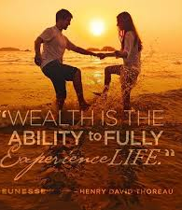
WEALTH

Slide 3
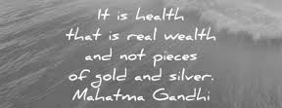
THE GREATEST WEALTH IS HEALTH

Slide 4
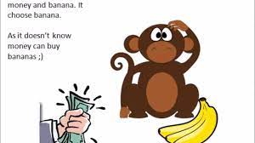
In reality, if you put money or health in front of people, they tend to choose money because many people don’t know that good health can bring more money and happiness in our life.
Health is most valuable asset of our life.

Slide 5
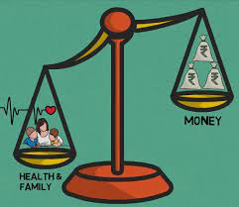
Health is more important than money

Slide 6
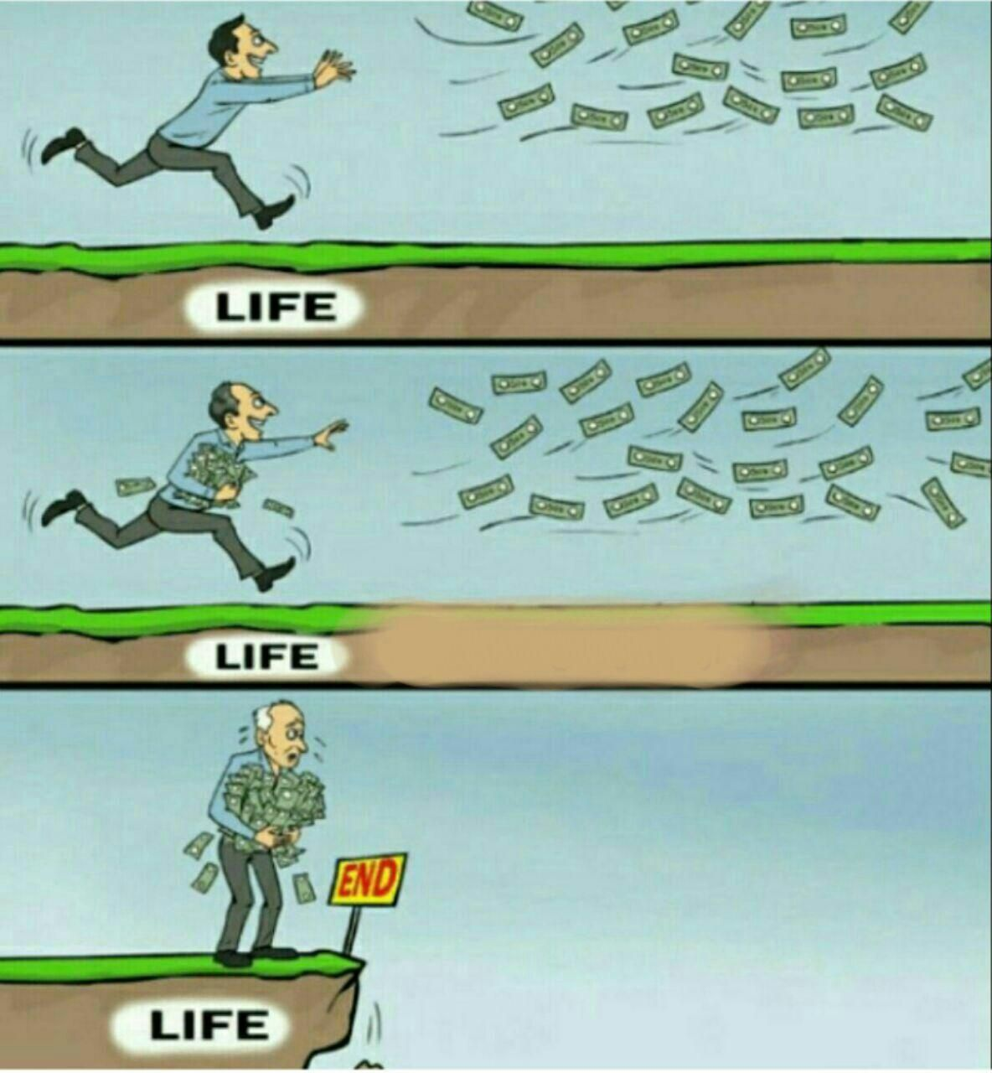

Slide 7
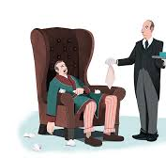

WHO IS WEALTHIER?....

Slide 8
Here’s Why Health is more important than money:
Health Cannot Be Bought
It Is Important To Have A Good Health To Earn Good Wealth
Health Is Important Because It Is An Important Source Of Your Happiness
Health Is Important Than Wealth Because It Stays Longevity And Happiness At All Stages Of Age
Health Is The Greatest Wealth

Slide 9
An Example
COVID-19

Slide 10




How To Maintain A Good Health?..

Slide 11
Everything can wait but health can’t. The Simple Rule is Work Hard, Earn Well, Stay Healthy, Help others and be Happy

Slide 12

References:
https://www.linkedin.com/pulse/health-more-important-than-money-marissa-fayer-mba/
https://smartechworld.in/health-vs-wealth/
https://www.quora.com/What-is-more-important-money-or-health

